Slide 1

MICRONUTRIENT IMBALANCE

Slide 2
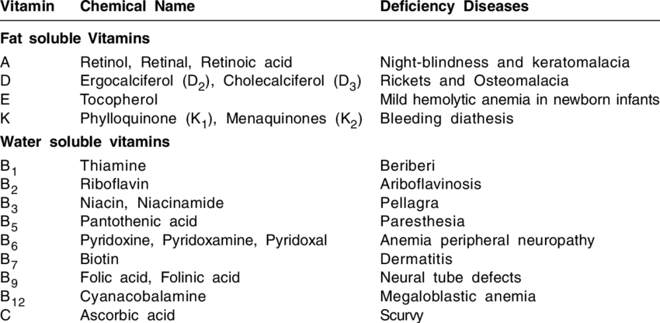

Slide 3
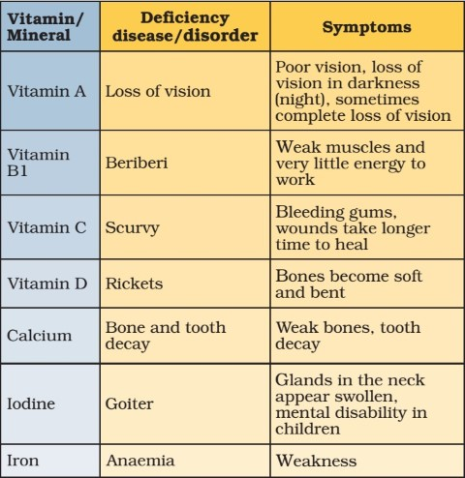

Slide 4
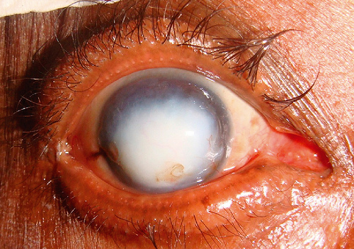
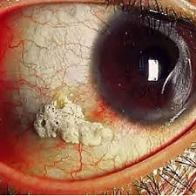
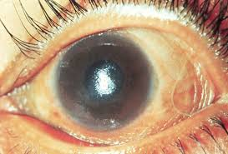

DEFICIENCY OF VITAMIN A (Retinoids)
VITAMIN A is a natural Antioxidant
Dry Skin
Night Blindness
Xeropthalmia
Bitot Spots
Keratomalacia
Infertility
Delayed growth
Frequent Infections
Poor Wound Healing
Bitot Spots
Keratomalacia
Xeropthalmia
Dry Skin

Slide 5
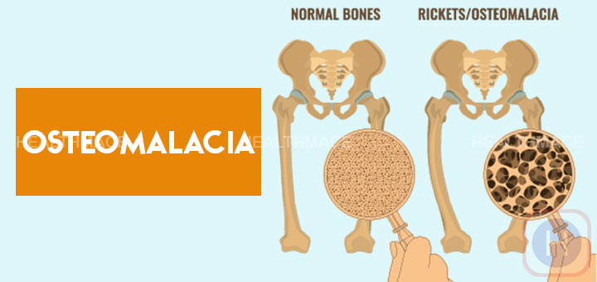
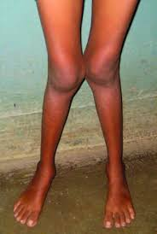
Deficiency of Vitamin D (Cholecalciferol)
A condition of soft and tender bones with less calcium absorption
RICKETS (Children)
OSTEOMALACIA (Adults)

Slide 6

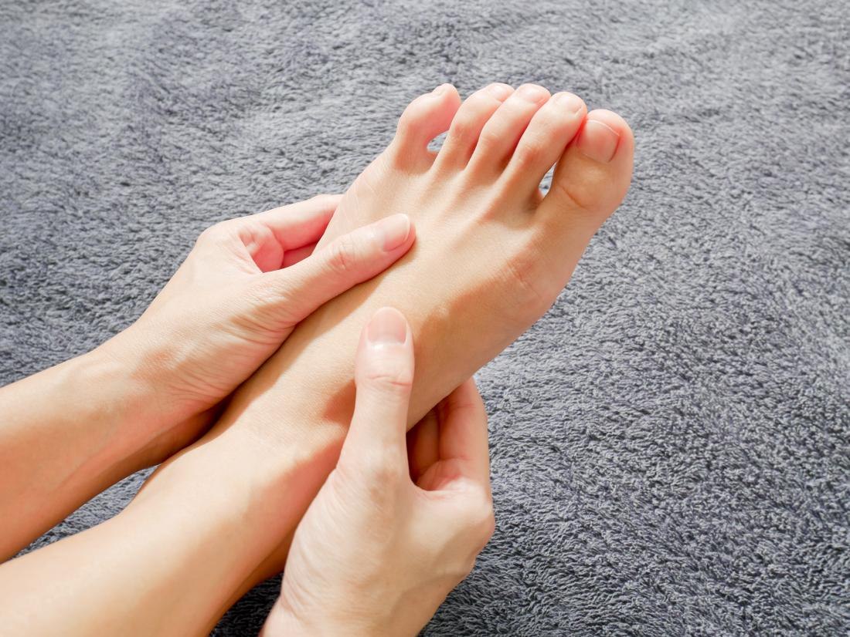

Deficiency of Vitamin E (Tocopherol)
Signs and Symptoms
Nerve and muscle damage
Numbness in the arms and legs
Loss of body movement control
Muscle weakness, and vision problems
Weakened immune system
Weakened immune system
Numbness
VITAMIN E is a natural Antioxidant
Muscle weakness

Slide 7
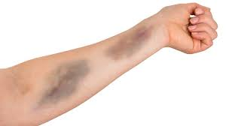

Deficiency of Vitamin K (Phylloquinone)
Signs and Symptoms
Bruising
Hemorrhage - Significant bleeding
Poor bone development
Osteoporosis
Increased cardiovascular disease
Bruising
Significant bleeding

Slide 8

Vitamin B1 (Thiamine)- Deficiency
Gastro Intestinal Beriberi
Abdominal Pain
Nausea
Vomiting
Wet Beri beri
Dry Beriberi
Difficulty in walking
Tingling or loss of sensation (numbness) in hands and feet
Loss of tendon reflexes
Loss of muscle function or paralysis of the lower legs
Mental confusion/speech difficulties

Slide 9
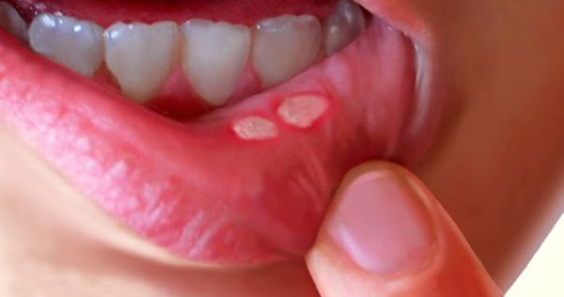
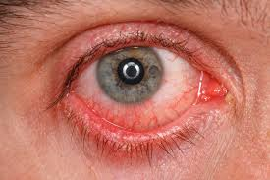
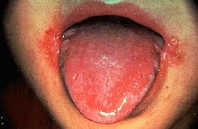
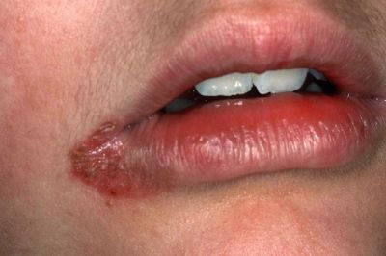
Vitamin B2 (Riboflavin) - Deficiency
Ariboflavinosis
Skin disorders
Hyperemia (excess blood) and edema of the mouth and throat
Angular stomatitis (lesions at the corners of the mouth)
Cheilosis (swollen, cracked lips)
Hair loss, reproductive problems
Sore throat
Itchy and red eyes
Degeneration of the liver and nervous system
Red eyes
Angular stomatitis
Cheilosis

Slide 10

Find your answer
1. Is it true that garlic oil increases vitamin B₁ absorption?
2. Can you get B vitamins from vegetables?

Slide 11
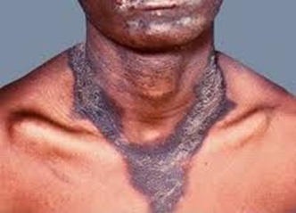
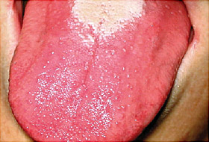
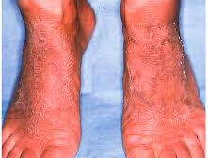
Vitamin B3 (Niacin) - Deficiency
Pellagra
Thick, scaly pigmented rash on skin exposed to sunlight
Swollen mouth and bright red tongue
Vomiting and diarrhoea
Headache
Apathy
Fatigue
Depression
Disorientation
Memory loss
Pigmented rash
Bright red tongue (Glossitis)
Scaly Skin

Slide 12
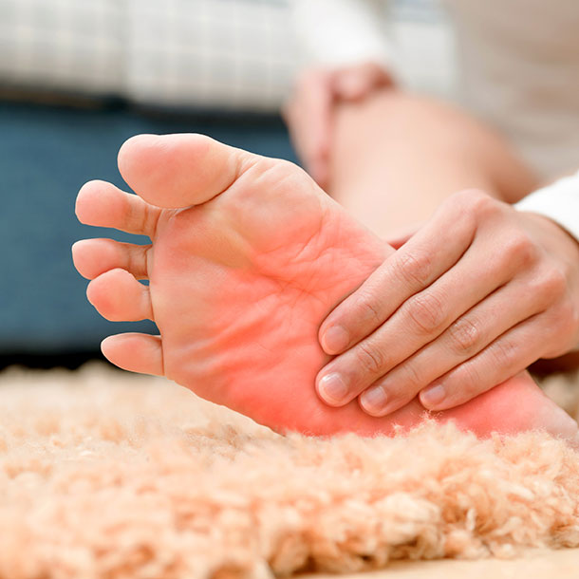
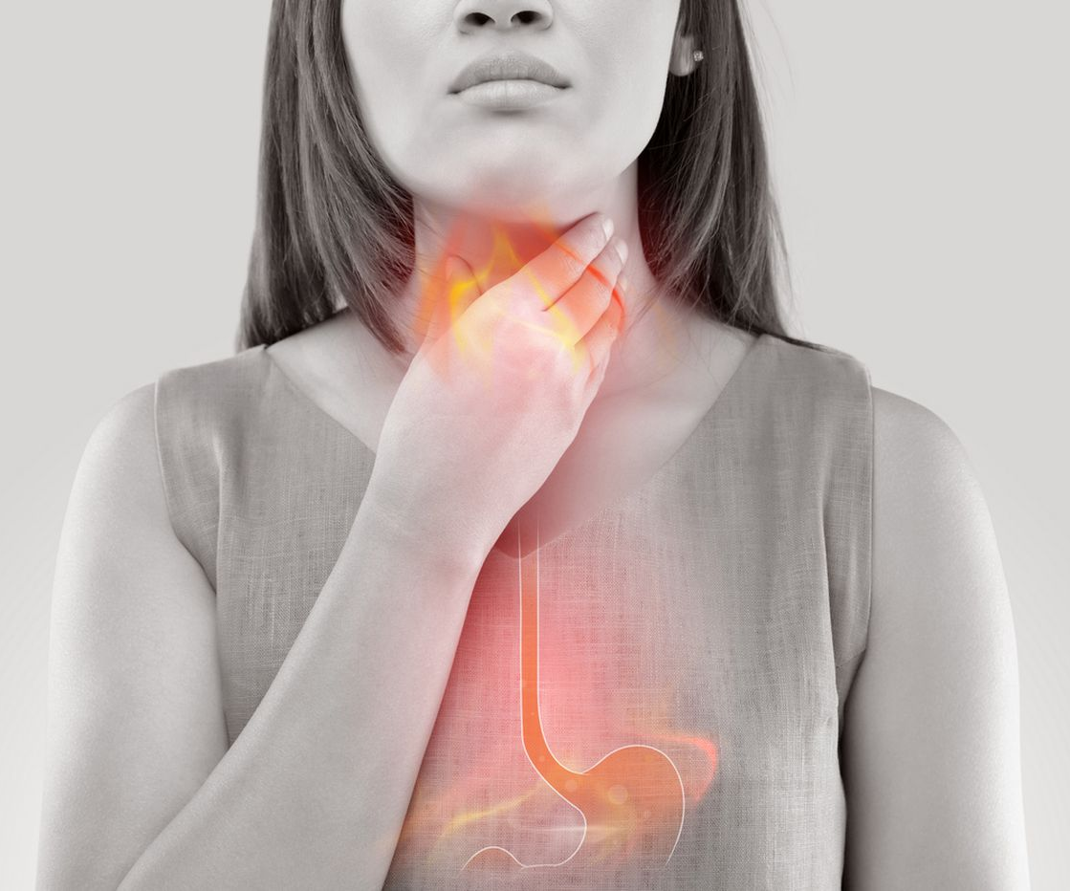
Vitamin B5 (Pantothenic Acid) - Deficiency
Numbness and burning of the hands and feet
Headache
Extreme tiredness
Irritability
Restlessness
Sleeping problems
Stomach pain
Heartburn
Diarrhea, nausea, vomiting, and loss of appetite.
Burning of the hands and feet
Heartburn

Slide 13
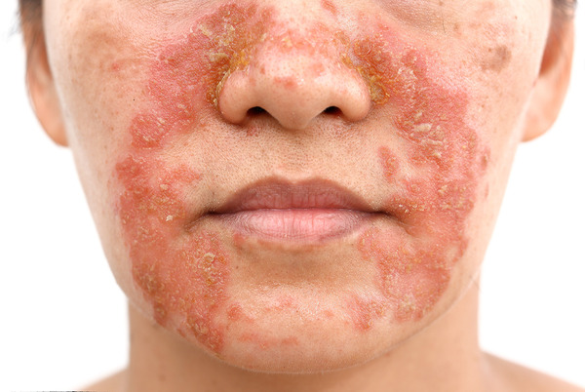
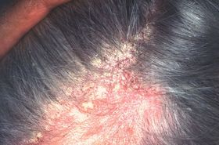
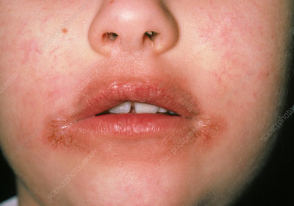
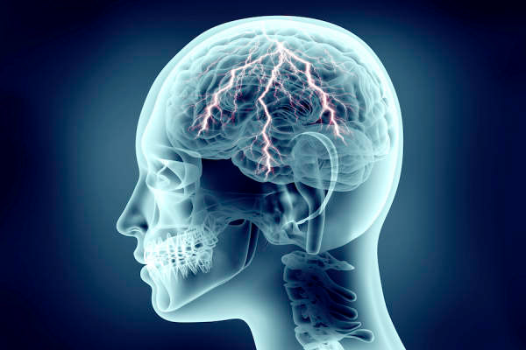
Vitamin B6 (Pyridoxine) - Deficiency
Dermatitis
Peripheral neuropathy
Seborrheic dermatitis
Glossitis and cheilosis
In adults, depression, confusion, and seizures.
Dermatitis
Seborrheic dermatitis
Seizures
Cheilosis

Slide 14
Find your answer
1. Niacin is involved in:
DNA repair.
Production of steroid hormones.
Converting carbohydrates into energy.
All of the above.
2. Is it better to take B complex or individual B vitamins?

Slide 15

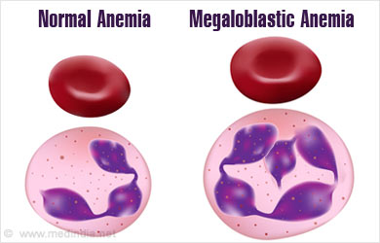
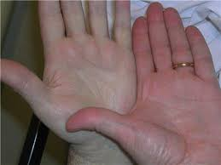
Vitamin B9 (Folic Acid) - Deficiency
Megaloblastic Anemia
Persistent fatigue.
Weakness.
Lethargy.
Pale skin.
Shortness of breath.
Irritability.
Lethargy
Megaloblastic Anemia
Pale skin

Slide 16


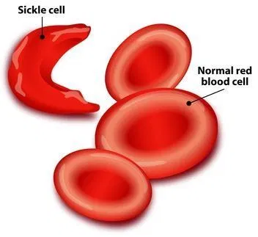
Vitamin B12 (Cyanocobalamin) - Deficiency
Heart palpitations
Pernicious Anemia (Microcytic Anemia/Sickle Cell Anemia)
Weakness, tiredness, or light headedness.
Heart palpitations and shortness of breath.
Pale skin.
A smooth tongue.
Constipation, diarrhea, loss of appetite, or gas.
Nerve problems like numbness or tingling, muscle weakness, and problems walking.
Vision loss.
Shortness of breath
Pernicious Anemia

Slide 17
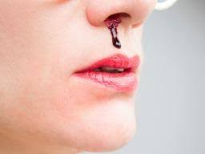
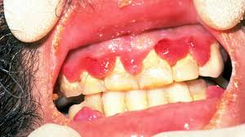
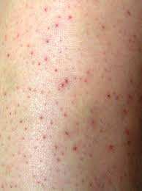
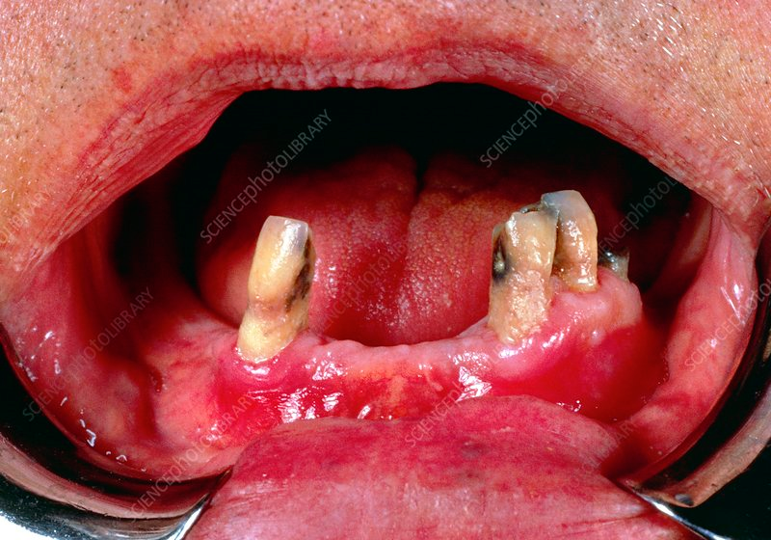
Vitamin C (Ascorbic Acid) - Deficiency
.
SCURVY
Tiredness and weakness.
Muscle and joint pains.
Easy bruising.
Red-blue bruises on your skin.
Poor healing of wounds.
Tooth loss
Dry skin.
Splitting hair.
Swelling and discoloration of your gums.
Sudden and unexpected bleeding from your gums.
Nose bleeds.
Bleeding Nose
Bleeding gums
Loose teeth and weak gums
Red Bruises

Slide 18
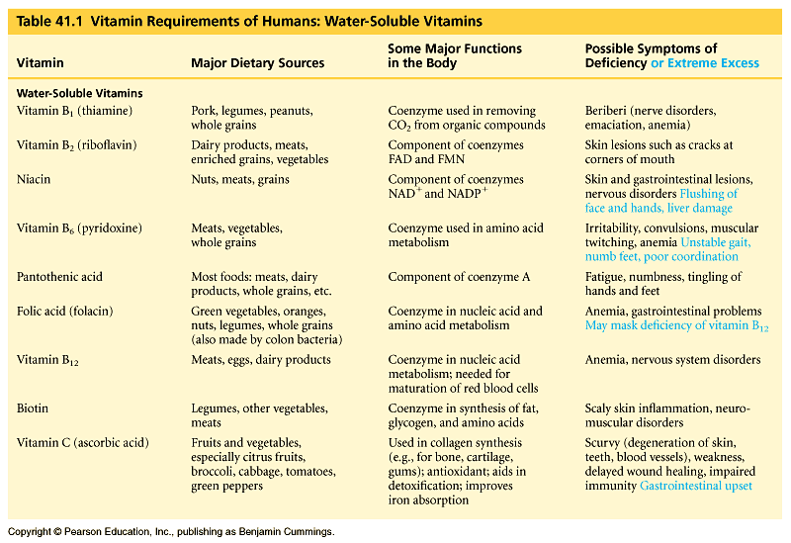
Overview of Water Soluble Deficiency

Slide 19
Find your answer
In the U.S., who is most likely to develop scurvy (vitamin C deficiency)?
A pregnant woman
A malnourished child
A person with the eating disorder anorexia nervosa
A long-time alcoholic
A person who does not eat meat, fish, eggs, or dairy products (vegan)
If I don’t smoke myself, but am around heavy smokers, are there any vitamins I should take more of?
When should folate be taken?

Slide 20
Find your answer
What Are The Functions of Calcium?
What Are The Functions of Iron?

Slide 21
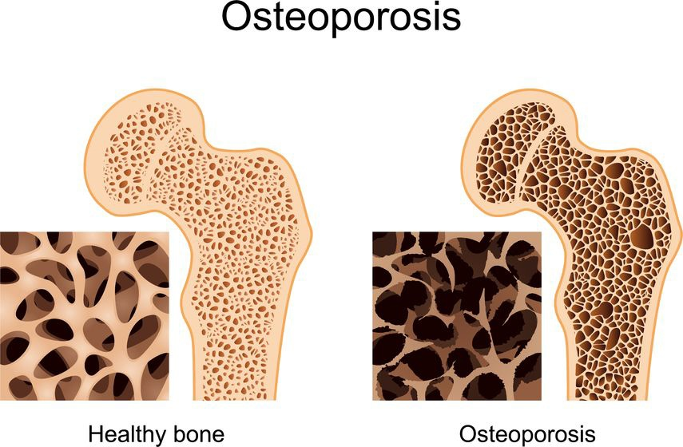

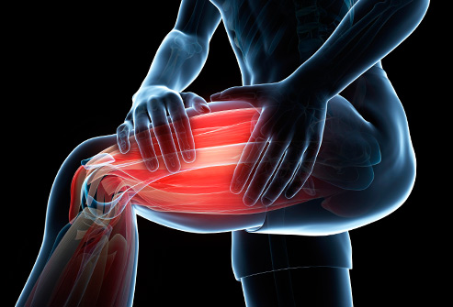
CALCIUM
Deficiency leads to:
Osteoporosis (Easy fracture of bones)
Hypocalcemia
Depression
Hallucinations.
Muscle cramps.
Weak and brittle nails.
Muscle spasms
Numbness and tingling in the hands and feet
Confusion and memory loss

Slide 22


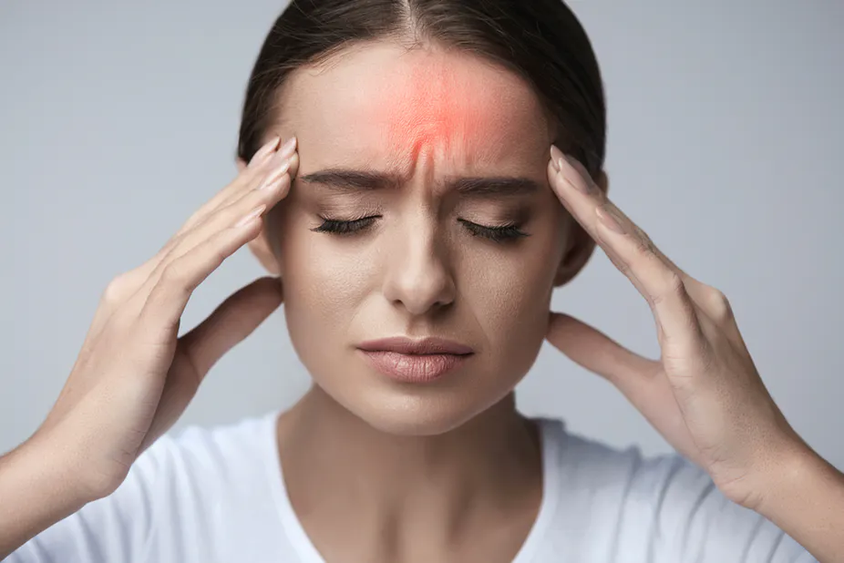

CALCIUM
Excess leads to:
Hypercalcemia
Fatigue and lethargy.
Frequent urination and thirst.
Headache
Nausea, constipation and/or loss of appetite.
Muscle aches
Memory problems, irritability and depression

Slide 23
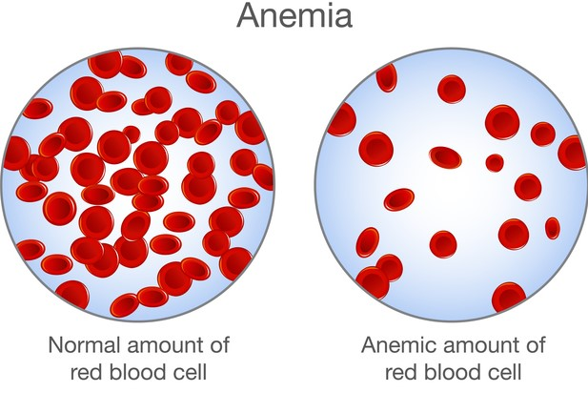
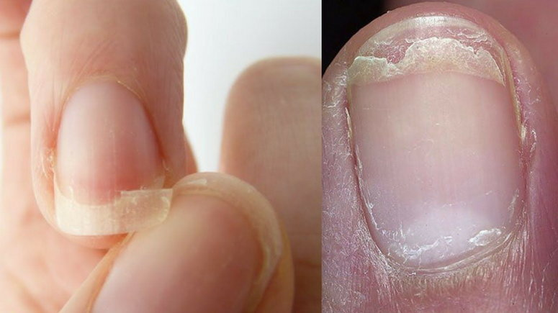

IRON
Deficiency leads to:
Anemia
Extreme fatigue
Weakness
Pale skin
Chest pain, fast heartbeat or shortness of breath
Headache, dizziness or lightheadedness
Cold hands and feet
Inflammation or soreness of your tongue
Brittle nails
Unusual cravings for non-nutritive substances, such as ice, dirt or starch
Poor appetite, especially in infants and children with iron deficiency anemia
Lowered blood hemoglobin count

Slide 24
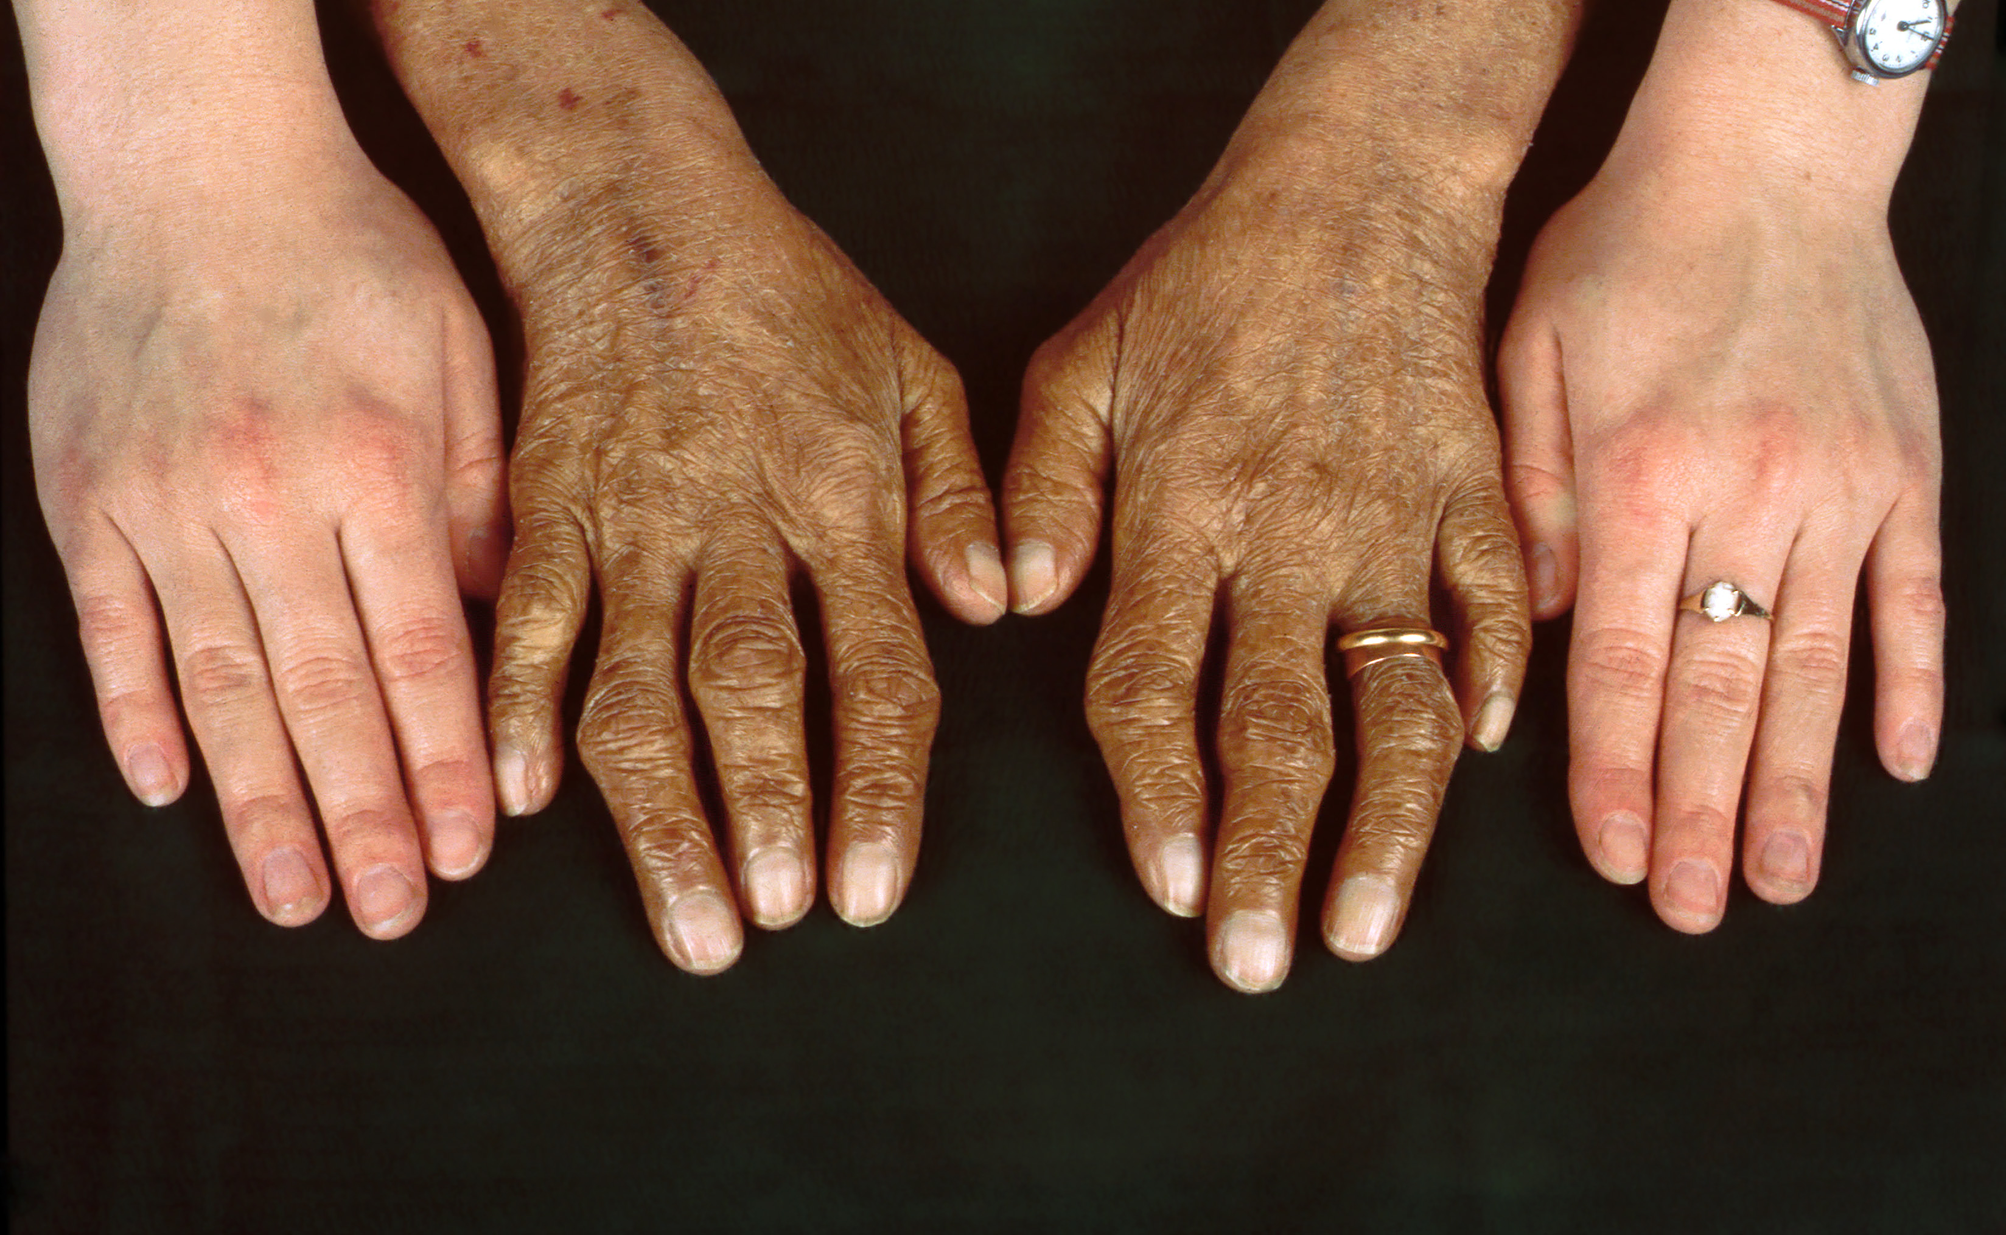
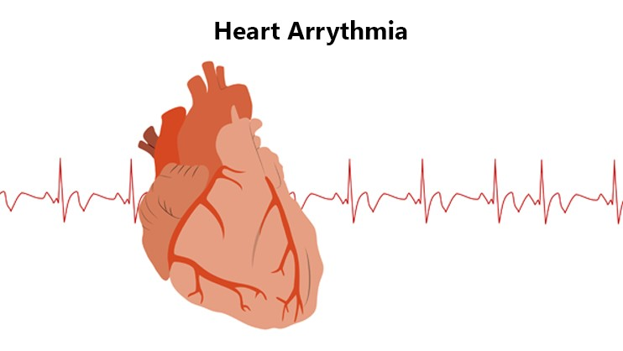
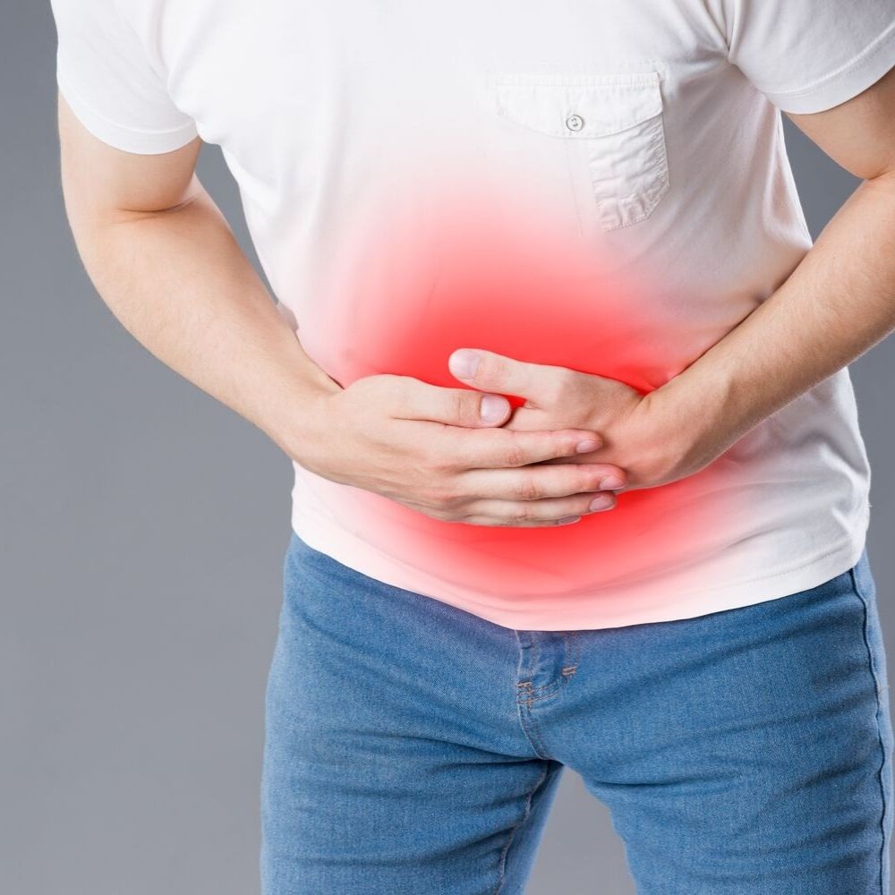
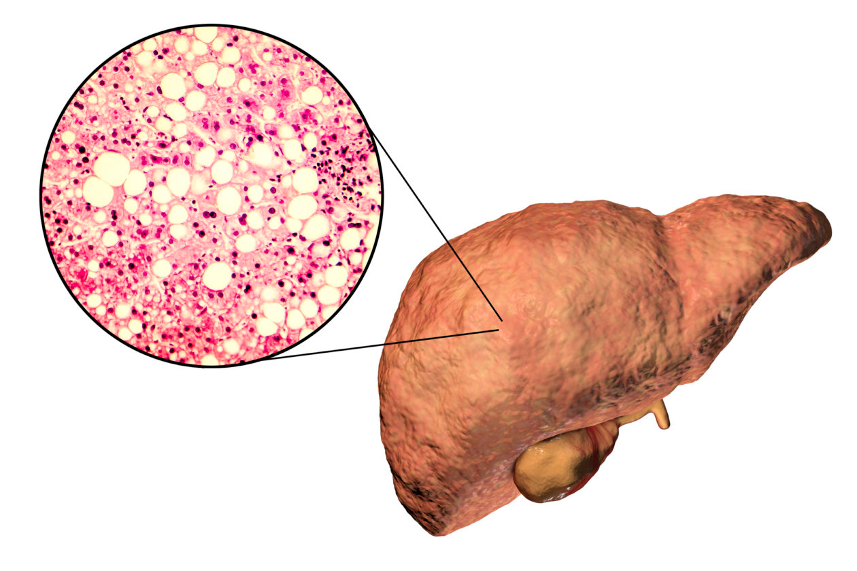
IRON
Excess leads to:
Hemochromatosis
Chronic fatigue.
Joint pain.
Abdominal pain.
Liver disease (cirrhosis, liver cancer)
Irregular heart rhythm.
Heart attack or heart failure.
Skin color changes (bronze, ashen-grey green)

Slide 25
Find your answer
What Are The Functions of Iodine?
What Are The Functions of Sodium?

Slide 26
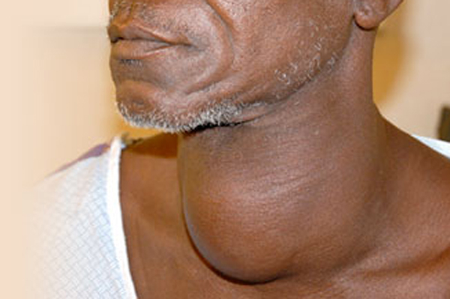
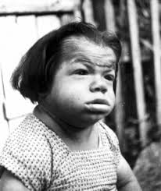
IODINE
Deficiency leads to:
Hypothyroidism (enlargement of the thyroid gland)- Goitre
Cretinism
growth retardation, developmental delay, and other abnormal features
Goitre
Cretinism

Slide 27
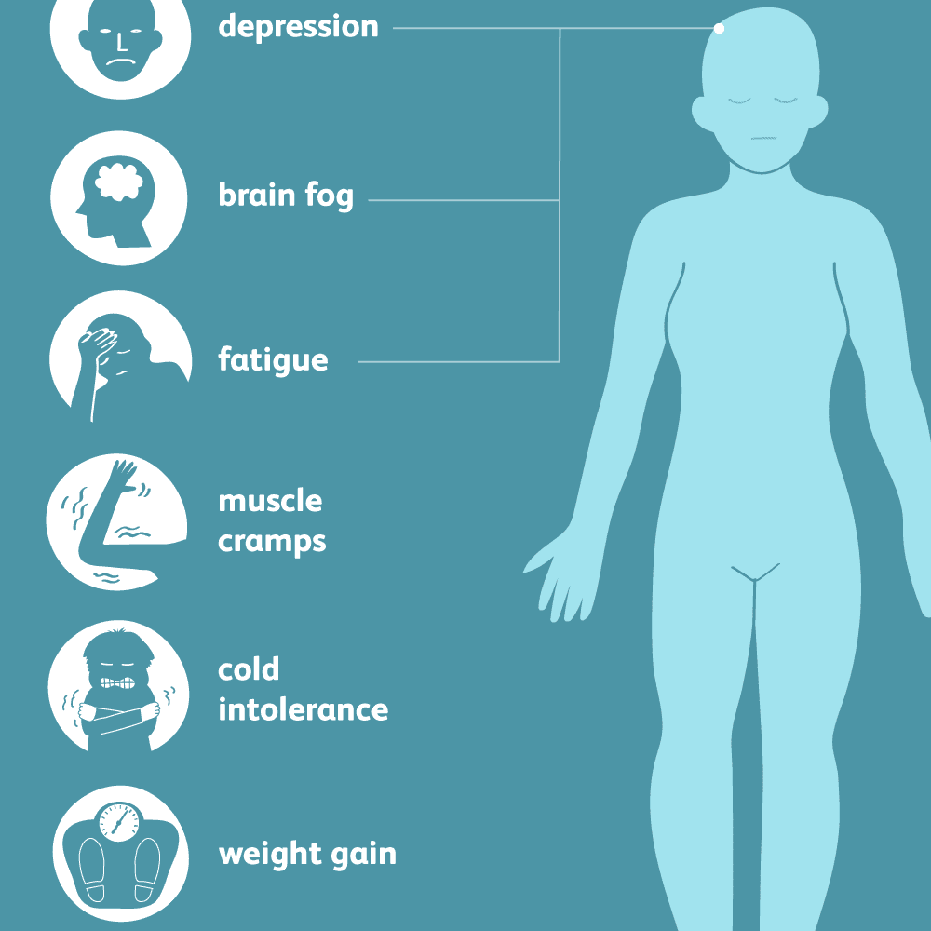
IODINE
Excess leads to:
Hyperthyroidism- Fatigue; Tremor, Insomnia
Symptoms of Hyperthyroidism

Slide 28
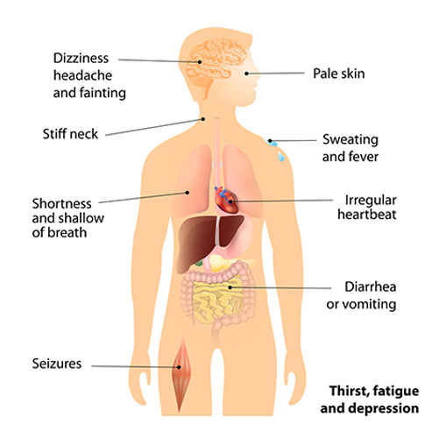
SODIUM
Symptoms of Hyponatremia
Deficiency leads to:
Hyponatremia (Low blood sodium)
Nausea, dizziness, lightheadedness, dehydration, blurred vision
Hypotension (Low blood pressure)

Slide 29
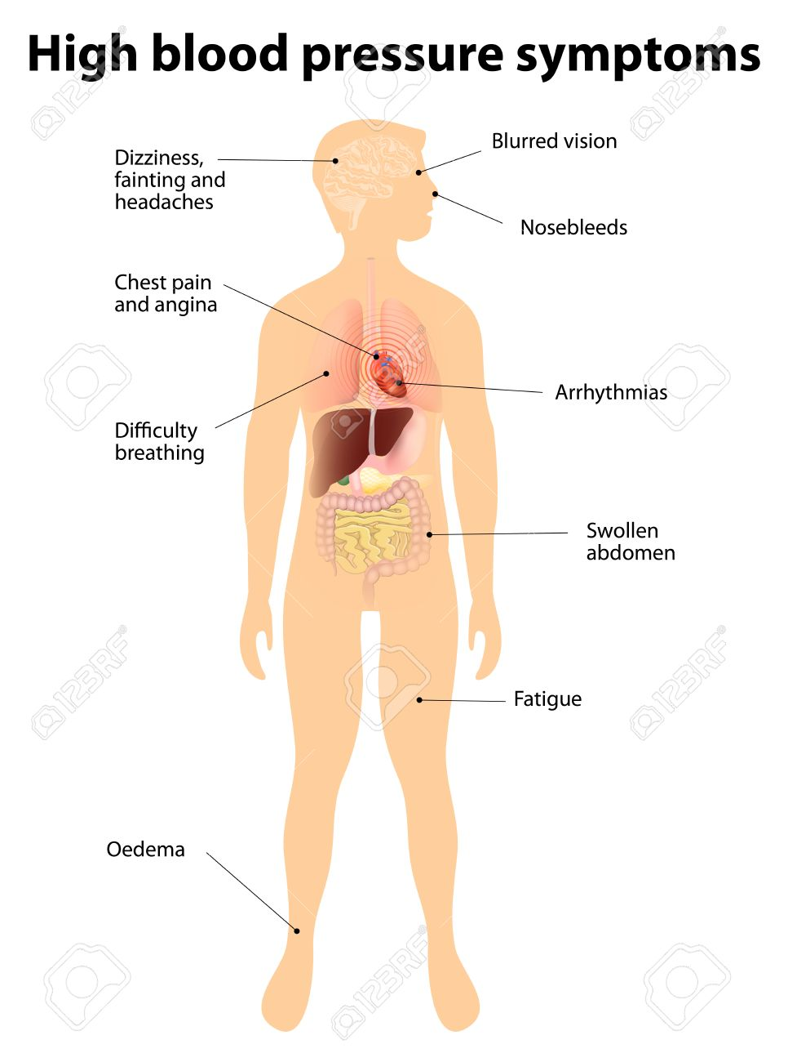
SODIUM
Excess leads to:
Hypernatremia (High blood sodium)
Shortness of breath.
Nosebleeds.
Flushing.
Dizziness.
Chest pain.
Visual changes
Headaches.
Hypertension (High blood pressure)

Slide 30
Find your answer
What Are The Functions of Potassium?
What Are The Functions of Phosphorus?

Slide 31
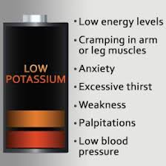
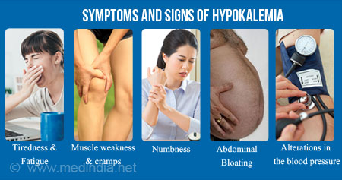
POTASSIUM
Deficiency leads to:
Hypokalemia:
Muscles cramp
Twingling and numbness
Muscle ache and stiffness
Heart palpitations
Mood changes
Breathing difficulty

Slide 32
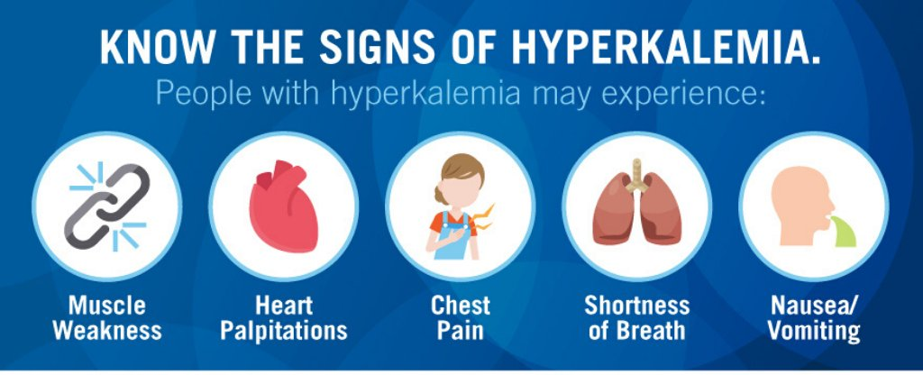
POTASSIUM
Excess leads to:
Hyperkalemia:
Tiredness or weakness.
Feeling of numbness or tingling.
Nausea or vomiting.
Trouble breathing.
Chest pain.
Palpitations or irregular heartbeats.

Slide 33
PHOSPHORUS
Deficiency leads to:
Hypophosphatemia:
Loss of appetite
Anxiety
Fragile bones and stiff joints,
Fatigue
Irregular breathing,
Irritability,
Numbness and weakness.
In children, decreased growth and poor bone and tooth development may occur.
Excess leads to:
Hyperphosphatemia:
Joint pain
Muscle pain
Muscle weakness

Slide 34
Find your answer
What Are The Functions of Zinc?
What Are The Functions of Magnesium?

Slide 35
ZINC
Deficiency leads to:
Growth retardation
Loss of appetite
Impaired immune function
Hair loss
Diarrhea
Delayed sexual maturation
Impotence hypogonadism in males
Excess Zinc leads to:
Nausea
Vomiting
Loss of appetite
Stomach cramps
Diarrhea
Headaches

Slide 36
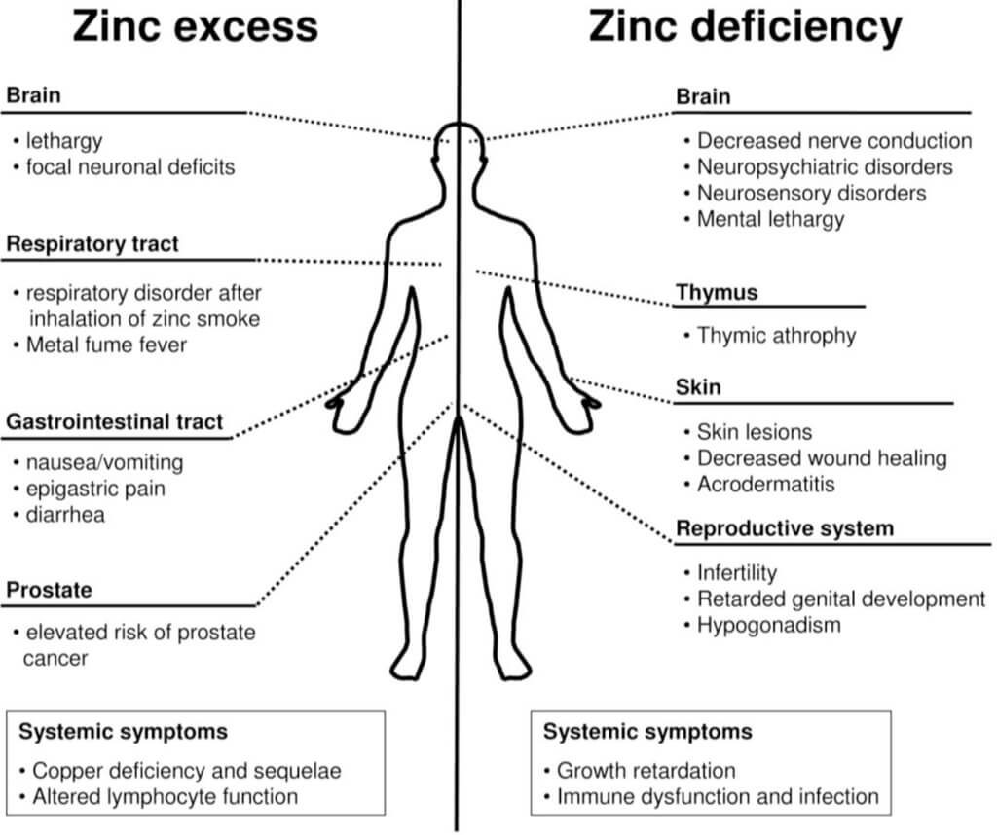

Slide 37
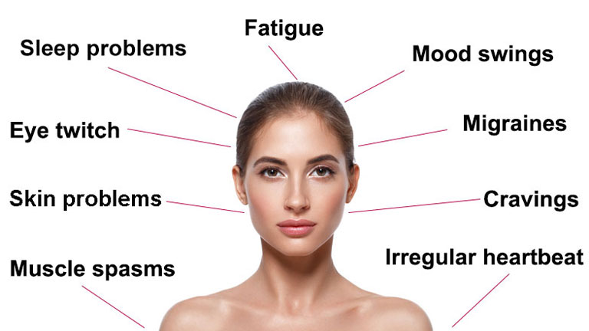
MAGNESIUM
Deficiency leads to:
Numbness
Tingling
Muscle cramps.
Seizures.
Muscle spasticity.
Personality changes.
Abnormal heart rhythms.
Excess leads to:
Digestive issues
Lethargy
Irregular heartbeat.

Slide 38
REFERENCE BOOKS
Food Science- Srilakshmi, Prosper Montague Publishing Group Ltd., Hamlyn, London. 2003.
Food & Nutrition- Swaminathan, The Bangalore Printing & publishing co ltd., Vol I, Second Edition, Bangalore (1995).
An Introduction to Lifestyle Management: Facilitator’s Handbook, Dr.Anja Morris-Paxton, 2019
DEVELOPED RESOURCE MATERIALS
Water Soluble Vitamins Developed PDF attached in Ample course content
LOCAL VIDEO DEVELOPED:
https://youtu.be/tMsrbSaBSFc - Video link is available in Ample course content

Slide 39

EAT THE BEST AND LEAVE THE REST

